Slide 1
Ecommerce DWH

Slide 2

Agenda
Source Data
Staging Layer
DWH Layer
Business Questions

Slide 3
Source Data
Overview of Source Data:
The data used for this project originates from 7 CSV files.
Each file represents a specific aspect of the system's data and contributes to the overall insights extracted during the analysis.
Key Characteristics of the Files:
Format: CSV (Comma-Separated Values)
Consistency: Structured data with predefined columns for each file.
Purpose: Provides input to the data warehouse, supporting the ETL process.

Slide 4
Source Files
File Name | Description
User | This file records customer information, including username, zip code, city, and state.
Seller | This file includes seller information such as ID, zip code, city, and state.
Order | This file contains details of all customer orders, including the order's status, timestamps for various stages (order date, approval, pickup, delivery), and estimated delivery time.
Order Item | This file provides a breakdown of items within each order, including product and seller IDs, pickup deadlines, price, and shipping cost for each item.
Payment | This file stores information about payment transactions, including the order ID, payment method, number of installments, and payment amount.
Products | Contains details about products sold, such as category, name, description length, number of photos, and dimensions (weight, length, height, width).
Feedback | This file records customer feedback for completed orders. It includes a unique feedback ID, the associated order ID, the feedback score, and timestamps for when the feedback form was sent and answered.

Slide 5

Staging Layer
The staging area serves as an intermediary storage space where raw data is temporarily loaded before it enters the Data Warehouse (DWH). During this stage, data is extracted from various source files (e.g., CSV files) and undergoes initial transformations such as cleaning, filtering, and formatting.

Slide 6
Staging Layer Characteristics
One-to-one Mapping: Each source file corresponds to a separate staging table.
Table Naming Convention: Tables are prefixed with STG_ followed by the file name (e.g., STG_FEEDBACK, STG_ORDER).
Separate Schema: Staging area is implemented in a separate schema to isolate raw data from the Data Warehouse.
Data Type Selection: Appropriate data types are carefully chosen for each staging table to optimize storage and query performance.
Data Loading with Pandas: Data is loaded into the staging tables using Pandas in a Python script, which handles:
- Reading the CSV files
- Performing necessary data transformations
- Inserting data into the staging area.

Slide 7
DWH Layer
Dimensional Modeling: The DWH is designed using a star schema, separating data into fact and dimension tables for optimized querying and reporting.
Fact Tables: Centralized tables storing transactional and measurable data:
FCT_FEEDBACK – Stores feedback-related data like feedback scores and dates.
FCT_ORDERS – Contains order lifecycle details, delays, and spending metrics.
FCT_PAYMENTS – Captures payment transactions, including type, installments, and value.
FCT_ORDER_ITEMS – Details of items in each order, including prices and shipping costs.

Slide 8
DWH Layer
Dimension Tables: Supporting tables providing descriptive attributes for slicing and dicing the facts:
DIM_DATE – Centralized date table with attributes like day, month, year, quarter, holiday, and weekend indicators.
DIM_CUSTOMERS – Stores customer demographic and geographic details.
DIM_PRODUCTS – Contains product attributes like category, weight, dimensions, and description length.
DIM_SELLERS – Includes seller-related geographic and demographic details.

Slide 9
DWH Layer
Relationships:
Fact tables connect to dimension tables via foreign keys (e.g., ORDER_ID, PRODUCT_ID).
Ensures consistency.
Optimized Schema:
Fact tables focus on quantitative data, supporting aggregation and calculations.
Dimension tables focus on descriptive data, enabling meaningful insights.
Data Transformation Process:
Data from the staging area is cleansed and transformed into the DWH schema. Transformations are performed using SQL scripts with INSERT INTO statements combined with SELECT queries to map and load data from staging tables into fact and dimension tables.
Examples of transformations include:
- Joining staging tables to derive calculated fields. - Converting raw dates into structured DATE_ID fields.

Slide 10
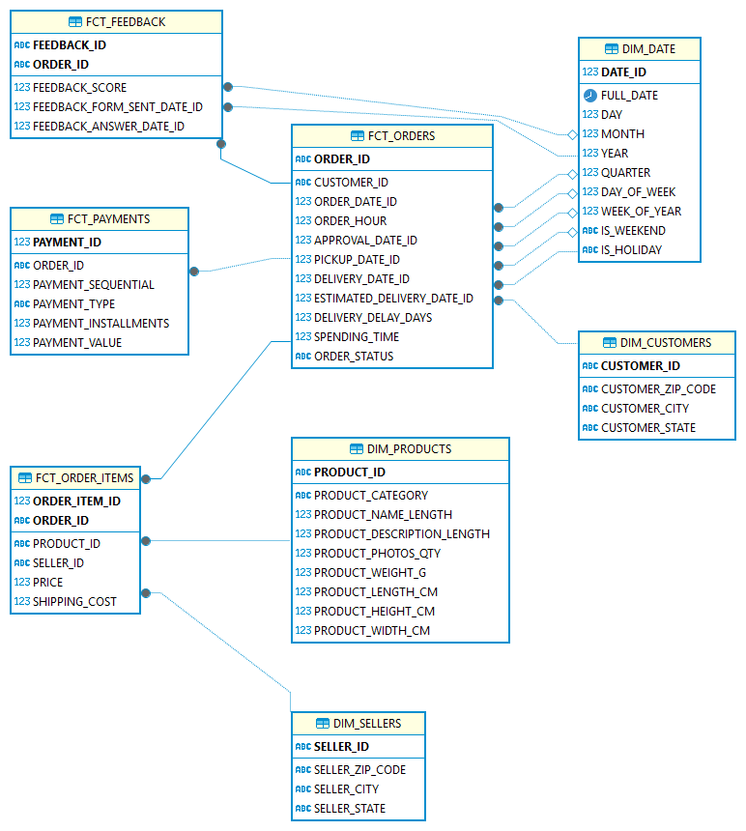
DWH ERD

Slide 11
Thank You

